Slide 1
Name Institution affiliation Course name Instructor Date

Slide 2
Introduction
A gap analysis is the procedure airports and airlines apply to determine the steps lacking from a required state of existence.
Gap analysis is performed in unique, structured, identifiable, and specific steps.
Notes:
A gap analysis is the procedure airports and airlines apply to determine the steps lacking from a required state of existence. Gap analysis is a comprehensive technique helping to evaluate and compare the aviation current and future state (SMS management tool, 2021).
It describes the current situation and develops goals for the expected conditions. Gap analysis is performed in unique, structured, identifiable, and specific steps. The process begins with a scope definition. After that, a description of how the study will be conducted.
The expected conditions are prearranged in the process, considering set regulations, performance indicators, standards, and so on (SMS management tool, 2021). The process is time-consuming, but with a clear and properly handled gap analysis, there will be time-saving in the long run, acquiring reliable results.

Slide 3
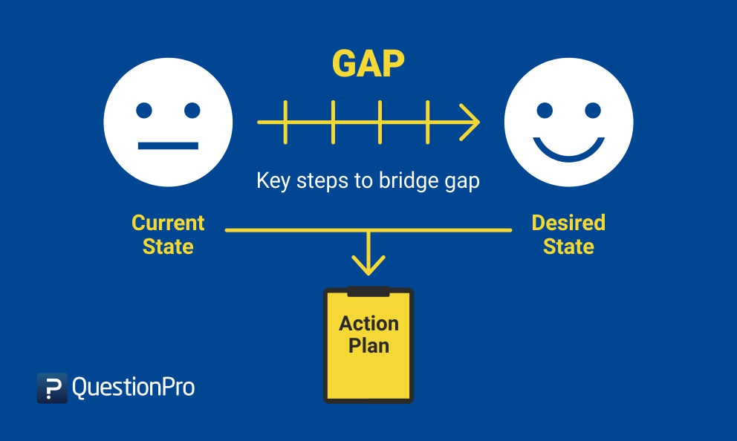
Why is gap analysis required in aviation SMS programs?
The gap analysis ensures that airlines can conduct a self-audit to determine the best-practice standards.
https://www.questionpro.com/blog/gap-analysis/
Notes:
The gap analysis ensures that airlines can conduct a self-audit to determine the best-practice standards. After the safety management team completes the gap analysis, it sets a road map for:
Preparation of a Safety Management System (SMS) implementation plan helps address and manage the likely shortcomings.
Successful preparation for external audits.
Understanding where the aviation industry should focus more time and the resources to correct inadequacies present in the aviation SMS (SMS management tool, 2021).
After performing a gap analysis, a company can identify how the SMS functions on every categorical level.

Slide 4
How is gap analysis prepared?
The gap analysis is a process that needs a model to work as intended as it is subdivided into sections like; hazard identification systems, regulations management etc.
Notes:
The gap analysis is a process that needs a model to work as intended as it is subdivided into sections like; hazard identification systems, regulations management, safety goals and objectives, analysis capabilities, investigation capabilities, and so on (Lutte, 2018).
Safety management divides the gap analysis into manageable sections to experts with skills to handle them. The following are scores on the SMS performance checklist.
0 shows no action performed.
1 shows action initiated but no action taken,
2 shows action take n to meet the requirements. It is demonstrated by observable employees’ actions, policies, and procedures.
3 shows an integration of required SMS elements with other SMS components and requirements.
4 shows evaluation and sustainability of required actions and proves that they can be sustained for a long time.
5 shows state of the art, which is verification as to whether the actions conform with the required standards and can be used to evaluate other companies.

Slide 5

Why are gap analyses performed?
Gap analysis has a variety of purposes which help to upgrade the aviation operations.
Safety managers perform the gap analysis
http://exclusive.multibriefs.com/content/gap-analysis-improves-associations/association-management
Notes:
There is a variety of reasons why aviation industries perform gap analysis:
They use the gap analysis to identify the best ways to implement their Safety Management Systems (SMS).
The aviation companies can adequately plan for their future aviation Safety Management Systems.
The companies can track, document, and file a continuous upgrading of the SMS.
Identify the inadequacies or gaps that are likely to be experienced in the aviation SMS.
It is necessary to note that, in small aviation companies, safety managers perform the gap analysis without needing any help from other experts (Müller, Wittmer, & Drax, 2014). However, in big and complex organizations, SMS managers delegate gap analysis task to a team of experts.

Slide 6
When to prepare the gap analysis
The gap analysis is the first activity a safety manager must address before starting to implement the aviation safety management system.
The gap analysis should be conducted and evaluated to ensure a sustainable process.
Notes:
The gap analysis is the first activity a safety manager must address before starting to implement the aviation safety management system.
Although many managers skip this gap analysis and go direct to the SMS implementation plan, this step is vital in ensuring that aviation safety is guaranteed. The gap analysis model needs to be more thorough compared to the SMS implementation plan (SMS management tool, 2021).
After completing the initial gap analysis, the safety manager may proceed to the SMS implementation plan but should have conducted and reviewed the entire process for its sustainability.

Slide 7
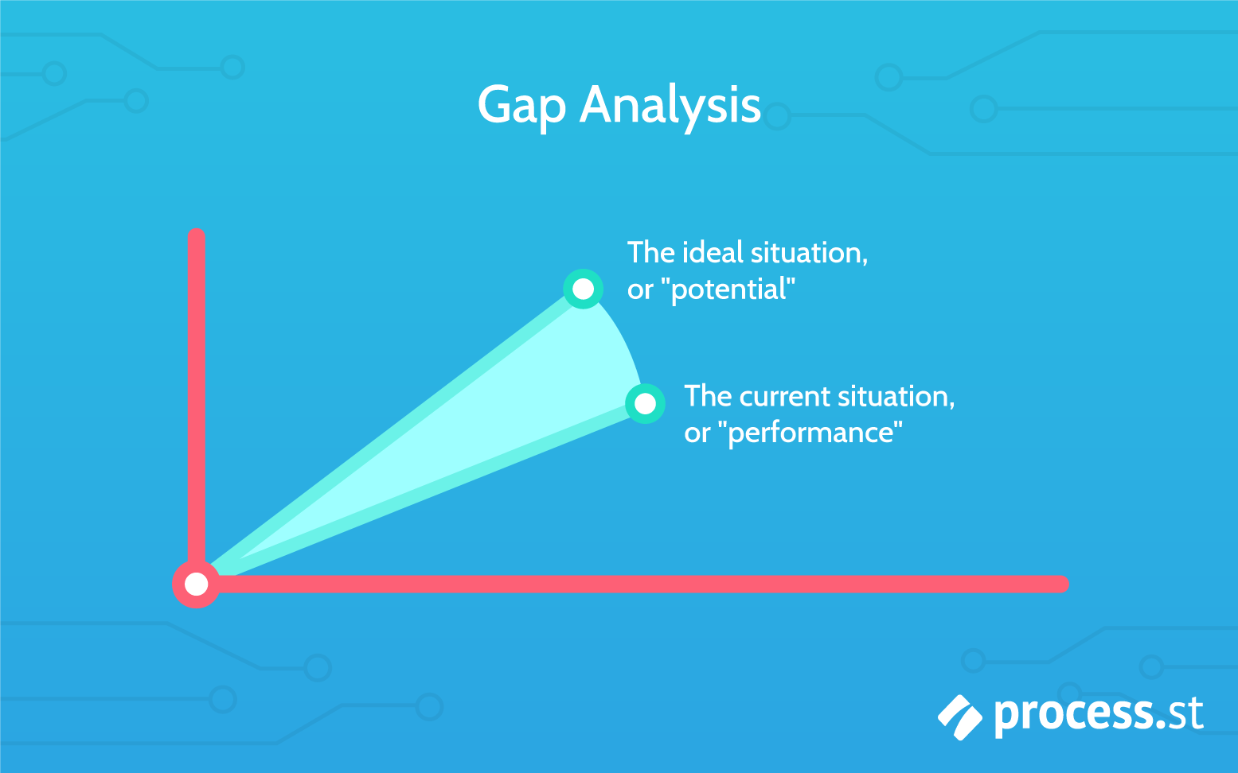
How to use an SMS gap analysis?
The SMS gap analysis focuses on the improvement and development of a standard SMS implementation plan.
The best SMS gap analysis acts as a road map
https://www.process.st/gap-analysis/
Notes:
The SMS gap analysis focuses on the improvement and development of a standard SMS implementation plan. The management goes through the SMS gap analysis checklist to compare the qualities of the aviation service provider’s operations with the models implemented (SMS management tool, 2021).
The best SMS gap analysis is essential in helping the safety managers develop an SMS implementation plan that acts as a road map.
Changes identified from a gap analysis are important as they show the existing gaps between the desired states and the current operations.
Gap analysis provides reports that determine the areas that are likely to demand improvements with minimal efforts and the SMS implementation areas that might need a longer period to be completed (Li, Ryerson, & Balakrishnan, 2019).

Slide 8
How gap analysis helps to monitor continuous improvement
The gap analysis tool is vital in ensuring that an organization conducts a regular gap analysis against regulatory standards.
The application helps check out the gap analysis and charts continuous improvement for a long period.
Notes:
The gap analysis tool is vital in ensuring that an organization conducts a regular gap analysis against regulatory standards, which are important in monitoring a continuous improvement process.
The application helps keep a good track of every gap analysis and charts continuous improvement for an extended period (SMS management tool, 2021). In the process, the manager can:
Perform the gap analysis as a way of determining the company’s strengths and weaknesses.
Compare the gap analysis historical background with much ease by use of graphs.
Document answers that help to review certain periods ranging from months to years.
Learn the essential requirements of the aviation safety management system through developing and operating routine gap analysis procedures

Slide 9
Conclusion
Gap analysis helps to examine current and future state of an aviation company,
It is a self-audit important to determine best-practice standards.
Notes:
Gap analysis is a technique essential in assessing and analyzing the aviation company’s current and future state.
The process begins with a scope definition followed by a description of how the entire process should be conducted by the company SMS manager or by delegated experts.
The gap analysis ensures that airlines can conduct a self-audit to determine the best-practice standards to ensure safety.
Applying the Gap analysis helps provide a report that provides details on essential areas to improve by adding resources or time.

Slide 10
references
Lutte, R. K. (2018). Aviation Outreach Model And Gap Analysis: Examining Solutions To Address Workforce Shortages. The Collegiate Aviation Review International, 36(1).
Müller, R., Wittmer, A., & Drax, C. (2014). Aviation Risk And Safety Management. Cham: Springer, 45-48.
Li, M. Z., Ryerson, M. S., & Balakrishnan, H. (2019). Topological Data Analysis For Aviation Applications. Transportation Research Part E: Logistics And Transportation Review, 128, 149-174.
Sms Management Tool, 2021. Gap Analysis - Aviation SMS Software Modules For Airlines & Airports. Retrieved April 25, 2021 From, Https://Www.Asms-pro.Com/Modules/Safetyassurance/Gapanalysis.Aspx

